Slide 1
HSC 509 Perspectives on Human Behaviour
Monsoon Semester 2022-23
Department of Humanities and Social Sciences
Indian Institute of Technology (ISM) Dhanbad

Slide 2
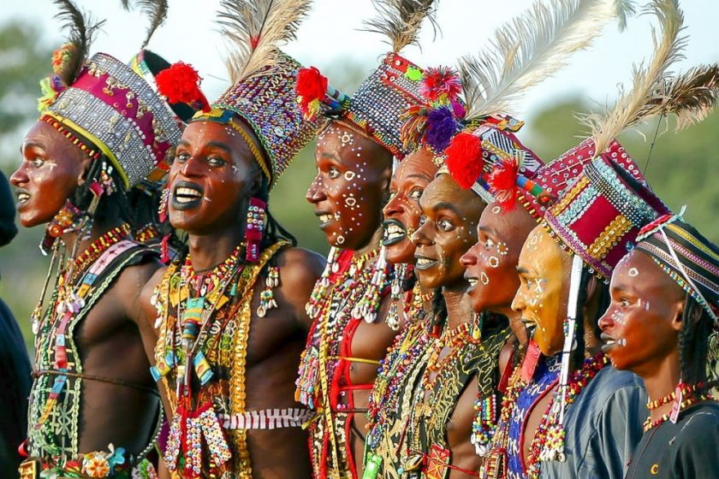
Gerewol Festival (some parts of Africa)

Slide 3
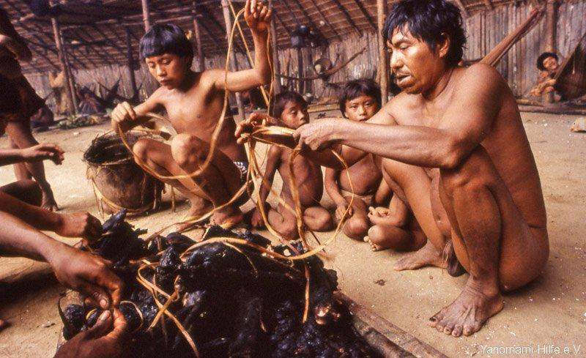
Yanomami Tribe (Brazil)

Slide 4
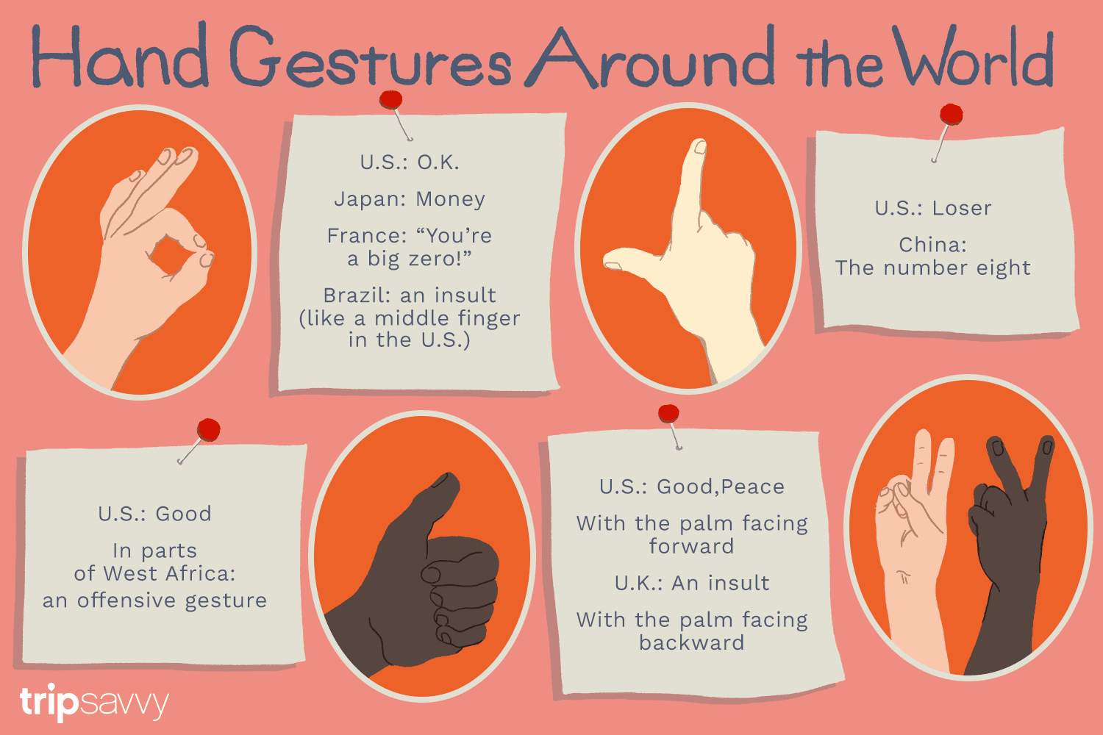

Slide 5
What is culture ?
“the ideas, customs, and social behaviour of a particular people or society”
“the values, beliefs and patterns of behaviour shared by a group of people”
“a way of life”

Slide 6
Culture Bias in Psychology
Shaped by a various factors and this is reflected in the differences in cultures
Psychology claims to be objective, value-free and universal
Value-free claim is seriously challenged here
Culture is an important explanation of behaviour

Slide 7

Culture Bias in Psychology: Some Stats
More than half of all psychology researchers were from US
Large number of participants were Americans
Most participants were ‘WEIRD’

Slide 8
Forms of Cultural Bias
Alpha and Beta Bias
More common distinction:
Ethnocentrism: my culture is the natural or right way of doing things
Cultural Relativism: understanding a behaviour in the context of its culture

Slide 9
Cultural Bias: The Dynamics
Perspectives
Emic: tries to understand the inside view of a culture
Etic: tries to understand culture from outside looking for universals
Cultural Bias occurs when emic and etic are applied wrongly
Imposed ‘Etics’: Ainsworth ideal attachment style
Design of tests of intelligence / aptitude / achievement
Wrongly applied Emic: ‘Honor Killings’

